Slide 1

Comparing selected Catholic and Àdìmúlà Responses to the Outbreak of COVID-19: An Appraisal of Contexts
Aquinas Day Lecture
28th January, 2021
AKIN-OTIKO, Akinmayowa (OP)
Institute of African and Diaspora Studies (IADS)

Slide 2
Introduction
COVID-19 a rude shock to the world
Researches in the area of health and finance abound.
My focus: Catholic Church and Àdìmúlà (the traditional religion of the Yoruba)
Why these two religions?
First they have both played prominent roles in the course of COVID-19.
Second, both have acted for the ‘common good’ of all beyond their members.

Slide 3
Problem
We judge responses without considering the the reality of religious pluralism.
Hard to tell if their actions worked as we still have COVID-19 with us.
Our reactions often ignore the context of each religion.

Slide 4
Focus and Methodology
Focus: Religious responses of the Catholic Church and Àdìmúlà to:
i) diagnoses, ii) treatment and iii) Coping with COVID-19.
Methodology: Comparative studies; data derived from FGDs (Priests from Lagos), Babaláwo (Lagos and Ibadan) and videos of responses.
Theory: Principle of Common Good

Slide 5
Basic Concepts
Àdìmúlà “as a religion is the worship of Olódùmarè who is called Òrìsà-Òkè (the divinity above)” (Akin-Otiko, 2015:39).
Babaláwo: Ifá priest who engages in divination and sacrifices for people.
Catholic Church: The Catholic Church, “sometimes referred to as the Roman Catholic Church.
COVID-19

Slide 6
Findings: Diagnosis
The Catholic Church: aligned with the positions of healthcare providers and scientist; encouraged all to do the same because of her mission to the all creation.
Àdìmúlà: Diagnosis was done through divination; the understanding of disease aetiologies within the confines of Àdìmúlà is wide.

Slide 7
Treatment/Prescriptions
Catholic Church: two purposes, salvation here and an eschatological one.
Salvation here - composed a prayer, offer masses, devotions to the Holy Eucharist and the Rosary
Encouraging COVID-19 Protocol
Eschatological – Prayer for the repose of the dead and ‘will die’ from COVID-19.

Slide 8
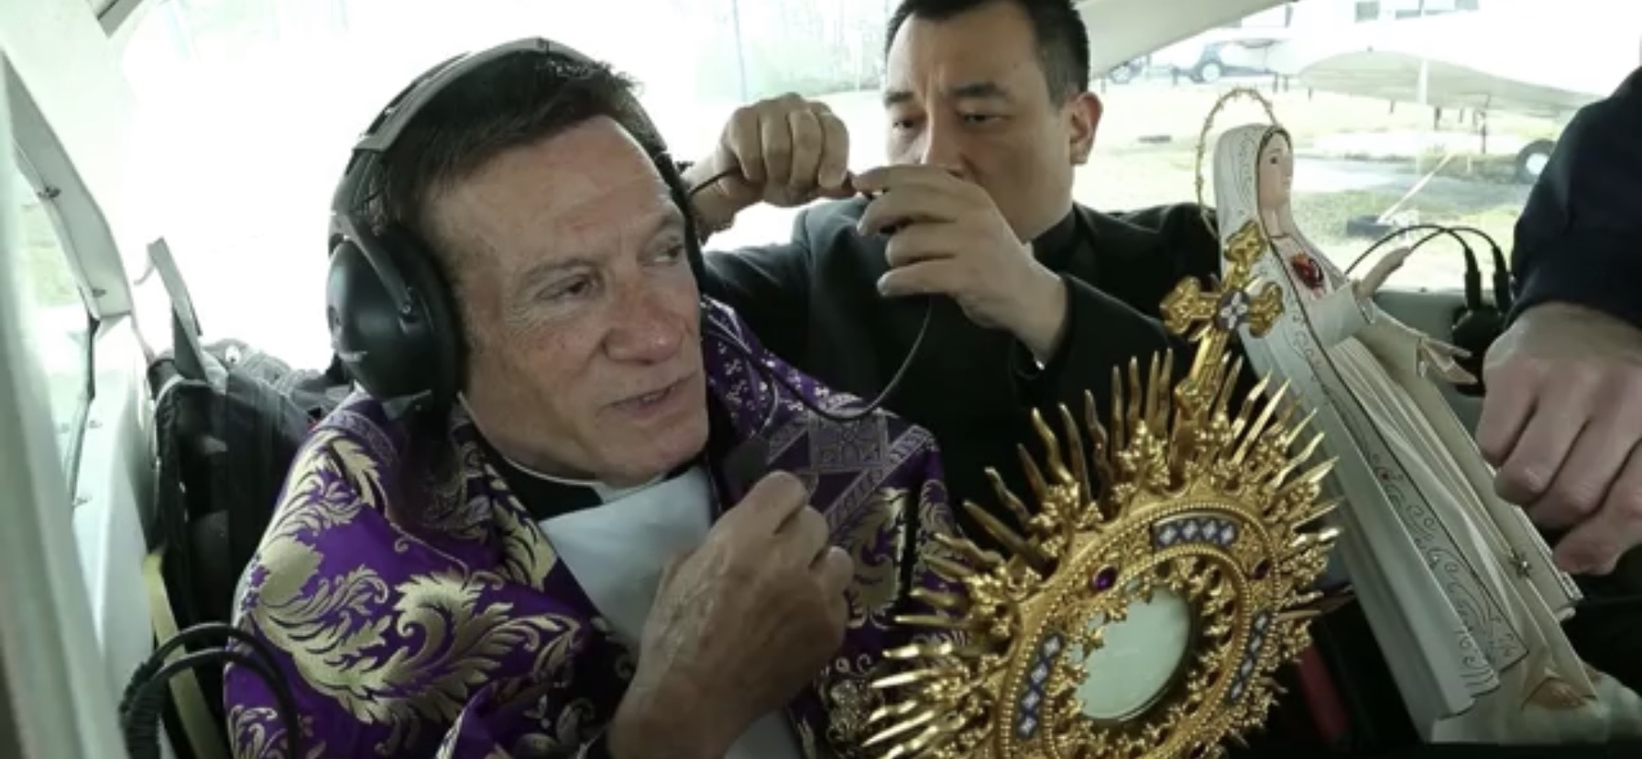
Fr. Anthony Manuppella preparing to fly with the Eucharist

Slide 9
Treatment/Prescriptions
Àdìmúlà: Divination to identify the spirit responsible and make required sacrifices to appease the spirit.
Herbs and native remedies
Ìwúre (prayer) this goes with everything that is done, because it is believed that Olódùmarè has the final say in everything.

Slide 10
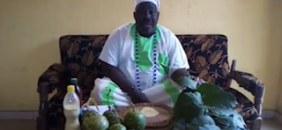
Dr. YSO Akande, diagnosing and prescribing remedies for COVID-19

Slide 11
Coping with COVID-19
Catholic Church: Compliance with the COVID-19 protocols.
Support the effort of government with medical facilities.
Prayers for the end of the Pandemic.
Àdìmúlà: More sacrifices and herbs

Slide 12
Discussions:
Common ground in responses
Both acted for the common good
Both deployed a blend of faith and reason.
Both believed that God has roles to play in the diagnosis, treatment and coping with diseases.

Slide 13
Uncommon grounds in responses
Significant differences between the two approaches
Operational contexts are quite different

Slide 14
Evaluation
Both worked for the ‘Common Good’ even though they had very different approaches.
Context and creed are crucial for the understanding of what has been done.
The nature of the Nigerian society, it is pluralistic in terms of religion.

Slide 15
Conclusion
Difficult to empirically assess the impact of Prayers on COVID-19.
Faith tells us that God has answered our prayers,
the Babaláwo tell us that their sacrifices are working.
Science tells us that all we need is the protocol and the curve will flatten.

Slide 16
Now you understand what they have been doing, theologians should help evaluate these responses so as to know the next step to take.

Slide 17
Thank you for your time.

